Slide 1
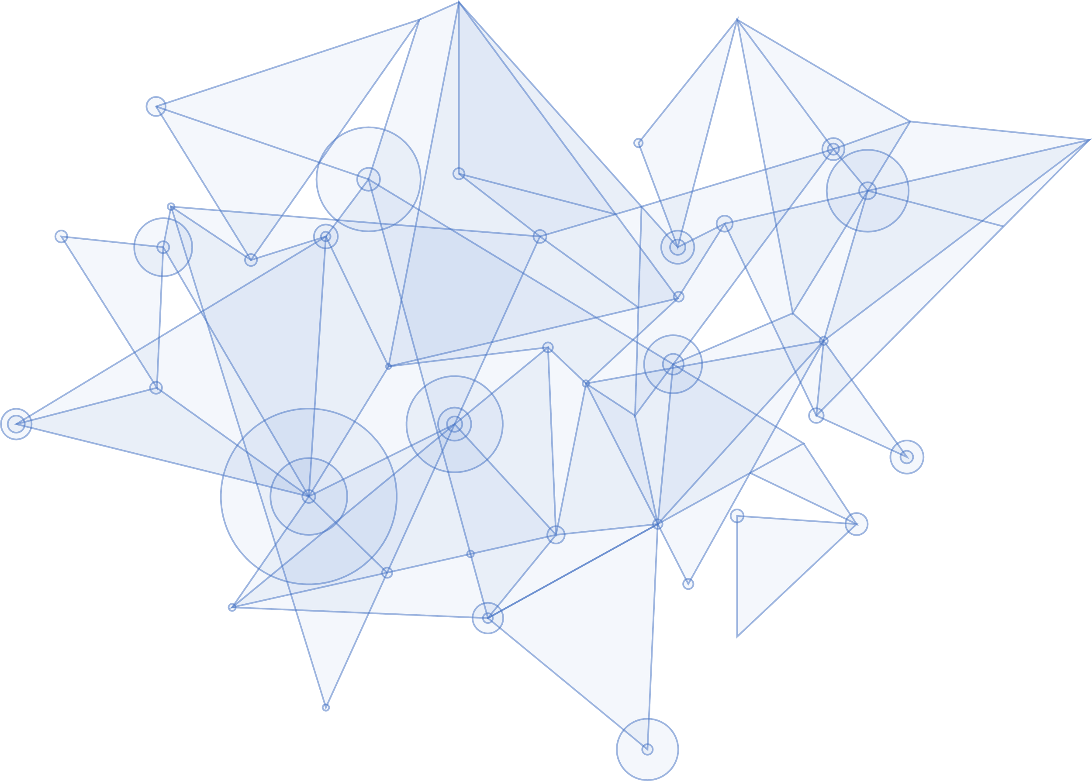
SEAL Project StudEnt And citizen identities Linked
Webinar April 2020
GRANT AGREEMENT UNDER THE CONNECTING EUROPE FACILITY (CEF) - TELECOMMUNICATIONS SECTOR AGREEMENT INEA/CEF/ICT/A2018/1633170.
Action No: 2018-EU-IA-0024
www.project-seal.eu

Slide 2
Agenda
01
Project Introduction
Project partners, objectives, value & outcomes
02
SEAL Linked Identity Soln / Arch
04
SSI Verifiable Credentials
Demo
High level overview of SEAL design & architecture
03
05
SEAL Verifiable Credentials &
Decentralised Linked Identities
Q&A
SEAL SSI Architecture and Service

Slide 3
Project Introduction
01

Slide 4
Introduction
StudEnt And citizen identities Linked
Project Duration: 24 months (April 2019 – March 2021)
Project partners:

Slide 5
Project Objectives
Enable interoperability between elDAS and Higher Education/Research (eduGAIN, ESC) e-identity schemes/ecosystems
Provide a SEAL Linking Service for HEI service providers to support interlinking of citizen and academic identities and attributes, and their verification (eIDAS, eduGAIN, ESC, ePassports, national eIDs etc.)
Support trusted 3rd party matching (outside SEAL) of the identities being linked e.g. banks, university enrolment administration
Provide students with mobile/web access for self-management of their linked identities, as well as the access control over their personal data
Reinforce integrity and accountability through the use of distributed ledger technologies

Slide 6
Value
SEAL Linking Service provides trusted interlinking of a citizen´s national and academic identities and attributes for HEI and 3rd party services
Enables students to authenticate with eIDAS or eduGAIN identities to cross-border student mobility services with interlinked ESC Identity in the authentication response
Reduces burden on HEIs to prove a student´s identity through external interface for manual / automatic linking to trusted 3rd parties dedicated at KYC processes
Follows the once-only principle, as e-identities are linked once by a trusted party, and then able to be re-used in many different scenarios
Identity attribute persistence across student life and beyond by providing linked credentials between expired student/citizen identities and current valid identities
Student empowerment giving them full control over their self-managed linked identities, storage on their devices, & sharing of their identity data with 3rd parties
Self-Sovereign Identity option for students to collect / verify their identities with mobile wallet technology
Notes:
Value of SEAL:
- There are many sources of academic identity and data belonging to a same citizen but with no relationship between them.
- Many potential use cases for services consuming this data require trusting on this relationship and not trusting the user (prevent borrowing data from someone else), thus, the paper-based stamped and signed documents.
Moving to a digital europe requires this data to be transferred and processed automatically, and the key is establishing the links between the data in the sources.

Slide 7
Outcomes
Open Source developed project: https://github.com/EC-SEAL
Microservices architecture providing modular functionality & scalability
Mobile first Dashboard App for user self-management of SEAL linked identities
Citizen centric approach where all personal data incl. linked identities are stored and managed under user control, and only shared with 3rd parties by user consent:
Personal Data Stores on user devices / 3rd party cloud storage
Issuing of eSEAL linked identities as W3C Verifiable Credentials to a user’s Self-Sovereign Identitiy Wallet (over distributed ledger technology)
AVOIDS central user database honey pot and data protection issues
Easy integration with common federated interfaces (SAML, OIDC) for Service Provider verification and Identity Provider delegated authentication
Live authentication sources,
Personal Data Store,
Self-Sovereign Identity Wallets
A simple linking level of assurance scheme

Slide 8
THANK YOU
for your attention
http://project-seal.eu/
This project has received funding from the European Union’s Horizon 2020 research and innovation programme under grant agreement No. 837854
www.seal.org

