Slide 1
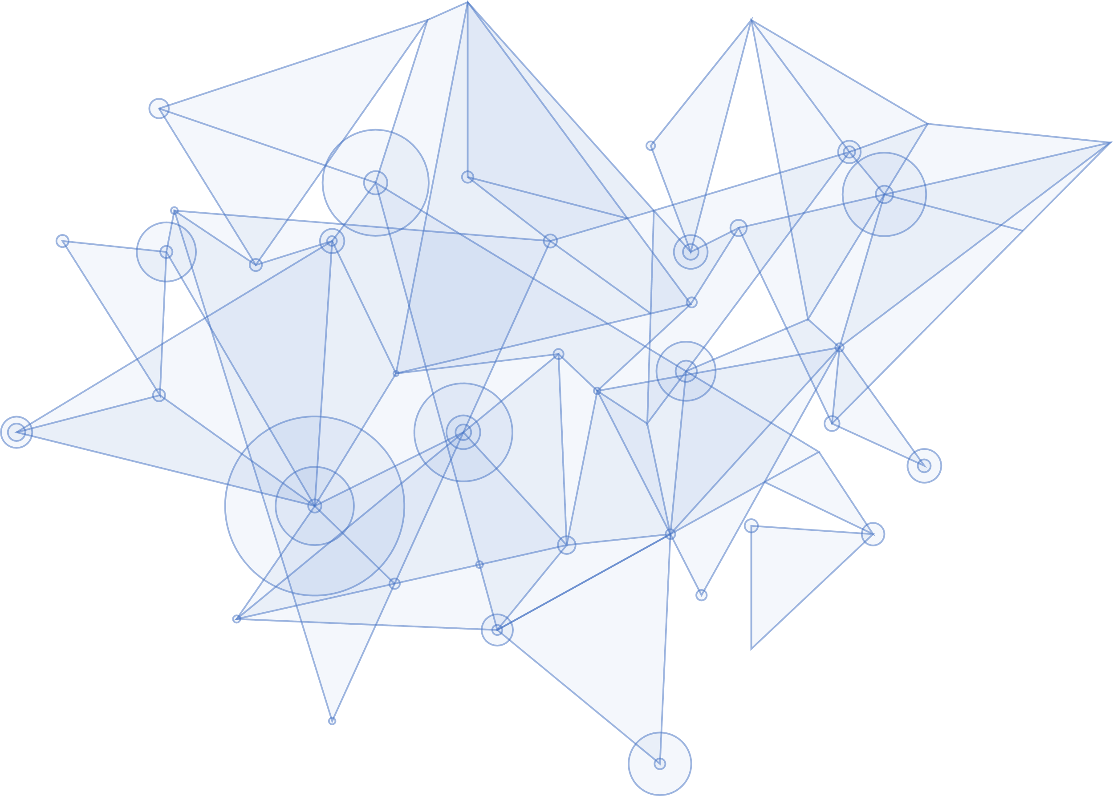
SEAL Project StudEnt And citizen identities Linked
Project Overview
GRANT AGREEMENT UNDER THE CONNECTING EUROPE FACILITY (CEF) - TELECOMMUNICATIONS SECTOR AGREEMENT INEA/CEF/ICT/A2018/1633170.
Action No: 2018-EU-IA-0024
www.project-seal.eu

Slide 2
Agenda Style
01
Project Introduction
04
Solution
Administrative project and partner information.
High level overview on how the project will achieve its goals
02
Background
05
Expected Benefits
Rationale and strategic environment in which the project is envisaged
The results expected after the solution is implemented
03
Objectives
Strategic and design goals the project must contemplate

Slide 3
Project Introduction
01

Slide 4
Introduction
StudEnt And citizen identities Linked
Project Duration: 24 months (April 2019 – March 2021)
Project partners:

Slide 5
Background
02

Slide 6
Background
The Digital Education Agenda
Overall objectives:
To enable students to identify themselves in a trusted manner
Once-only principle
Create a recognisable European Student identity
Connect digitally the information systems of higher education institutions
Allow the exchange of academic student data
Digitalise administrative processes of managing student mobility
European Parliament call “to create a European Student eCard which would grant the status of EU student in a mobility context and offer access to services”.

Slide 7
Background
European Student Card Initiative
DG EAC & CNECT promote synergies between Erasmus+ & CEF projects for a common solution
Create a unique student e-identifier
Enable institutions to exchange student data & manage student mobility in streamlined processes
Enable students to apply for and manage their mobility and access student e-services
Securely share authenticated personal data and qualifications (ECTS)
Smartphone access

Slide 8
Objectives
03

Slide 9
Project Objectives in a Nutshell
Enable interoperability between elDAS and Higher Education/Research (eduGAIN, ESC) e-identity schemes/ecosystems
Provide a SEAL Linking Service for HEI service providers, support for management of interlinking of different identities and attributes, and support for integration of these services.
Empower students by giving them mobile access to usable, self-managed linked identities, as well as the rights/control over their personal data
Build the means to support trusted 3rd party matching of a user´s multiple e-identities, that could be reused in different scenarios

Slide 10
Business and policy context
We promote use of CEF eID building block in the academic domain
We also promote related initiatives and convergence towards single student e-identity
We contribute to application of once-only principle for cross-institution e-services in academic domain
We enable identity attribute persistence and exchange across student life and beyond
We reinforce integrity and accountability through the use of distributed ledger technologies and are in contact with the relevant EU initiatives

Slide 11
Design and Requirements
The core of SEAL is the identity reconciliation
Main functionality of SEAL is to act as a trusted authority to issue information about the relationship between different identities and data sets.
To do so, it must interact with users through service interfaces
Federated service interfaces
Issuing of Verifiable Claims for Self-Sovereign Identity environments
The SEAL Service must be able to absorb future changes
Abstract, modular and extendable design
Provide module interfaces for all common functionalities
The technical implementation hidden within each module implementation

Slide 12
Design and Requirements
Other requirements
Modular abstract design should support different implementations
Should have connectors to several identity and personal data sources
Provide a framework to harmonise the identity reconciliation procedures
Provide distributed storage means to avoid concentrating sensitive data
Self-sovereign environment
Support distributed ledger operation: verifiable claims issuing and validation, based on the collected data.

Slide 13
Solution
04

Slide 14
Solution Principles
Citizen centric approach where all personal data incl. linked identities are stored and managed under user control, and only shared with 3rd parties by user consent
NO central user database to avoid honey pot and data protection issues
Mobile first Dashboard App approach for management of SEAL linked identities
Support linked identities held in personal datastores on user devices / 3rd party cloud storage
Support common federated interfaces (SAML, OIDC) for Service Provider verification and Identity Provider delegated authentication
Support Self-Sovereign Identities over distributed ledger, with issuing of SEAL linked identities as W3C Verifiable Credentials
Provide a simple linking level of assurance between identities

Slide 15
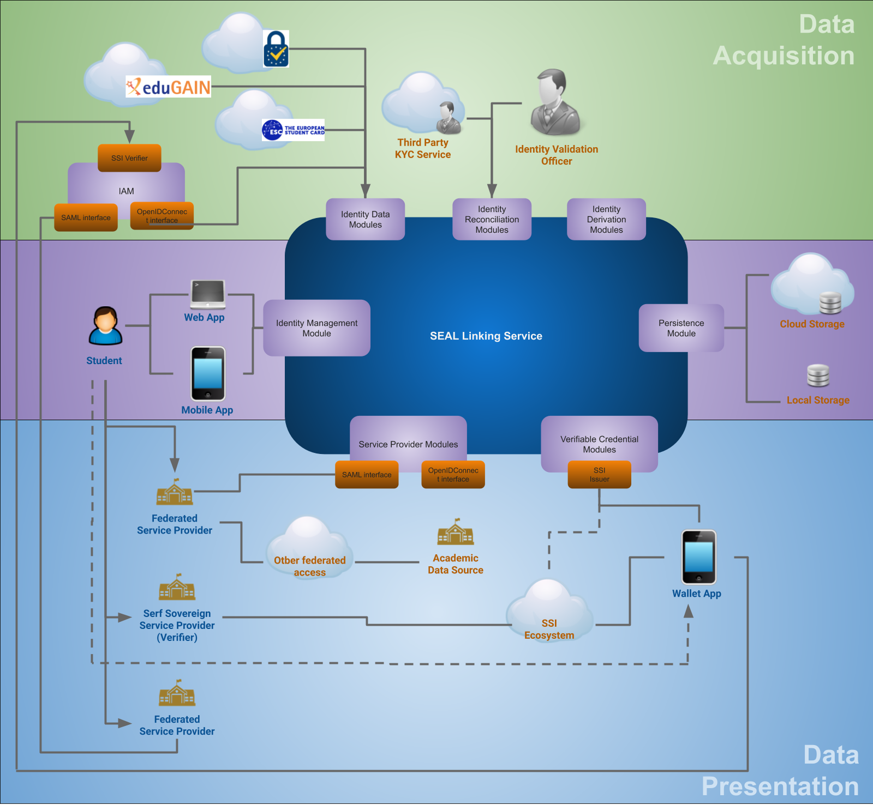
Architecture Diagram

Slide 16
SEAL Solution
Identity Management Module: main business logic of the service, interacts with user interface.
Identity Data modules: to obtain delegated authentication or retrieve trusted user data sets (Users can add available digital identities to their identity store: eIDAS, eduGAIN, European Student Identifier, orcID, ePassport, etc.).
Identity Reconciliation Modules: Receive requests and implement a trusted mechanism to establish to which assurance level two datasets belong to the same individual, through comparisons or additional validation data request. Validation methods may be local or remote, automated, semi-automated or manual.

Slide 17
SEAL Solution
Identity Derivation Modules: allow generating new identifiers strongly linked to the authenticated identity. They can be used to mitigate credential theft in specific use cases, and to prevent traceability or provide anonymity to a user while still having the trust of a strong identity being behind.
Service Modules: e-Services consume the delegated authentication and/or the identity linking information, to grant access to the user and establish a relationship between data sets received from different sources.
Verifiable Claim Generation Modules: Self-Sovereign Identity reduces dependency on the infrastructure, so these modules allow to generate standard self-validating objects containing the data sets and the linking information. This way, Consumers can receive this objects offline, without relaying directly on the SEAL service.

Slide 18
Service Characteristics
User data is stored on user-space storage
Data is stored only when (and if) she commands to
Identity Store is created upon access, stores identity data gathered during the session.
Usability settings can be stored on server-space, but no personal info on them
User-centric privacy aware architecture so that sharing of data is under user control and consent.
A user can access different instances of SEAL carrying her own data with her
Different instances can have different functional modules connected (identities, identity linking procedures, etc.)
Most of the functionality will be server-side
Will support client-side modules for specific use cases
Web and mobile user interfaces common and minimal logic (web will be a subset of the mobile client)

Slide 19
Expected Benefits
05

Slide 20
Steps Towards European Student Card
SEAL is a user service, to manage his personal data
User always has the control on his data: which data to release, whom and when
Stored on her own, can delete anytime
Also, SEAL is a service for services
Will provide authoritative info on the assurance of a link between two identities
Trusted third parties will assert this link
New mechanisms can be added
Will allow a student to build his own unique lifetime identity
By linking all of her available identifiers, past and present
eduGAIN, eIDAS, ESC, EWP, OrcID, Passport, etc.
Support all relevant academic and citizen identities

Slide 21
Expected Benefits
For the identity sources:
Reduced workload, thanks to the trusted self sovereign identity
Improved interoperability between identity realms
Procedures designed to assure the trust on the imported data
Avoid Data Honeypots thanks to data being kept by the user herself
Different solutions available: cloud, mobile wallet, local storage, to provide a better experience and resiliency.

Slide 22
Expected Benefits
For the end-user:
Will be able to get, pair and operate all unrelated e-identities owned
User-centred: he decides at all times which information is gathered and released and for how long, and she keeps the information on his premises
Web and mobile client
Thanks to the trusted self sovereign identity:
Anonymous identity if desired
Less dependency on third parties
Identity and credential exposure reduced by derived identities
Identities and credentials bootstrapped at the user’s demand
Temporary or persistent
Anonymous while still trusted
Link with eIDAS identity can be proved if the user allows to

Slide 23
Expected Benefits
For the Service Provider:
Reduced dependency on the IdP, less central failure points
Procedures designed to assure the trust on the imported/generated data, so only trusted data is provided from SEAL
All data issued or proxied comes with a level of assurance, to support multiple trust-level operations.
Access to trusted identity linking information from users
Thanks to the trusted self sovereign identity
Issued verifiable claims come with a level of assurance
Distributed verification info on the distributed ledger
Link with eIDAS identity can be proved on demand

Slide 24
Expected Benefits
Others:
Model is designed to take into account extensions to other sectors, including banking identities or trusted validators, and other public and private sector actors.

Slide 25
THANK YOU
for your attention
To contact or keep up with the latest news, refer to our project web page
www.project-seal.eu
GRANT AGREEMENT UNDER THE CONNECTING EUROPE FACILITY (CEF) - TELECOMMUNICATIONS SECTOR AGREEMENT INEA/CEF/ICT/A2018/1633170.
Action No: 2018-EU-IA-0024
www.seal.org

